Slide 1

Power Platform Dataflow Intro
Jinyu Xu | GPS CSA

Slide 2
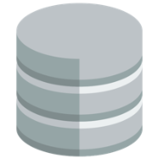
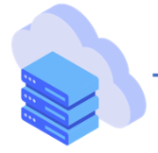


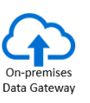
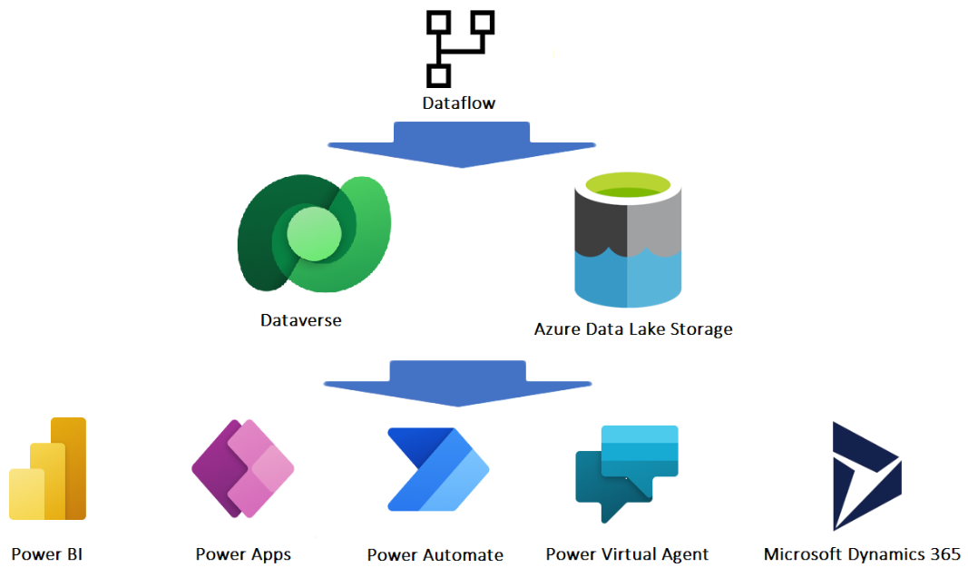
Dataflow integration with Microsoft Power Platform and Dynamics 365
Use-case scenario for dataflows
Data migration from legacy system, using PowerApps for the new user interface experience rather than the legacy on-prem system.
Creating your own custom tables to unify data across your organization.
Creating Power BI reports and dashboards thar leverage dataflow data.
Creating integration with Azure Data and AI service via your organizations’ Azure Data Lake Storage Gen2 account.

Slide 3
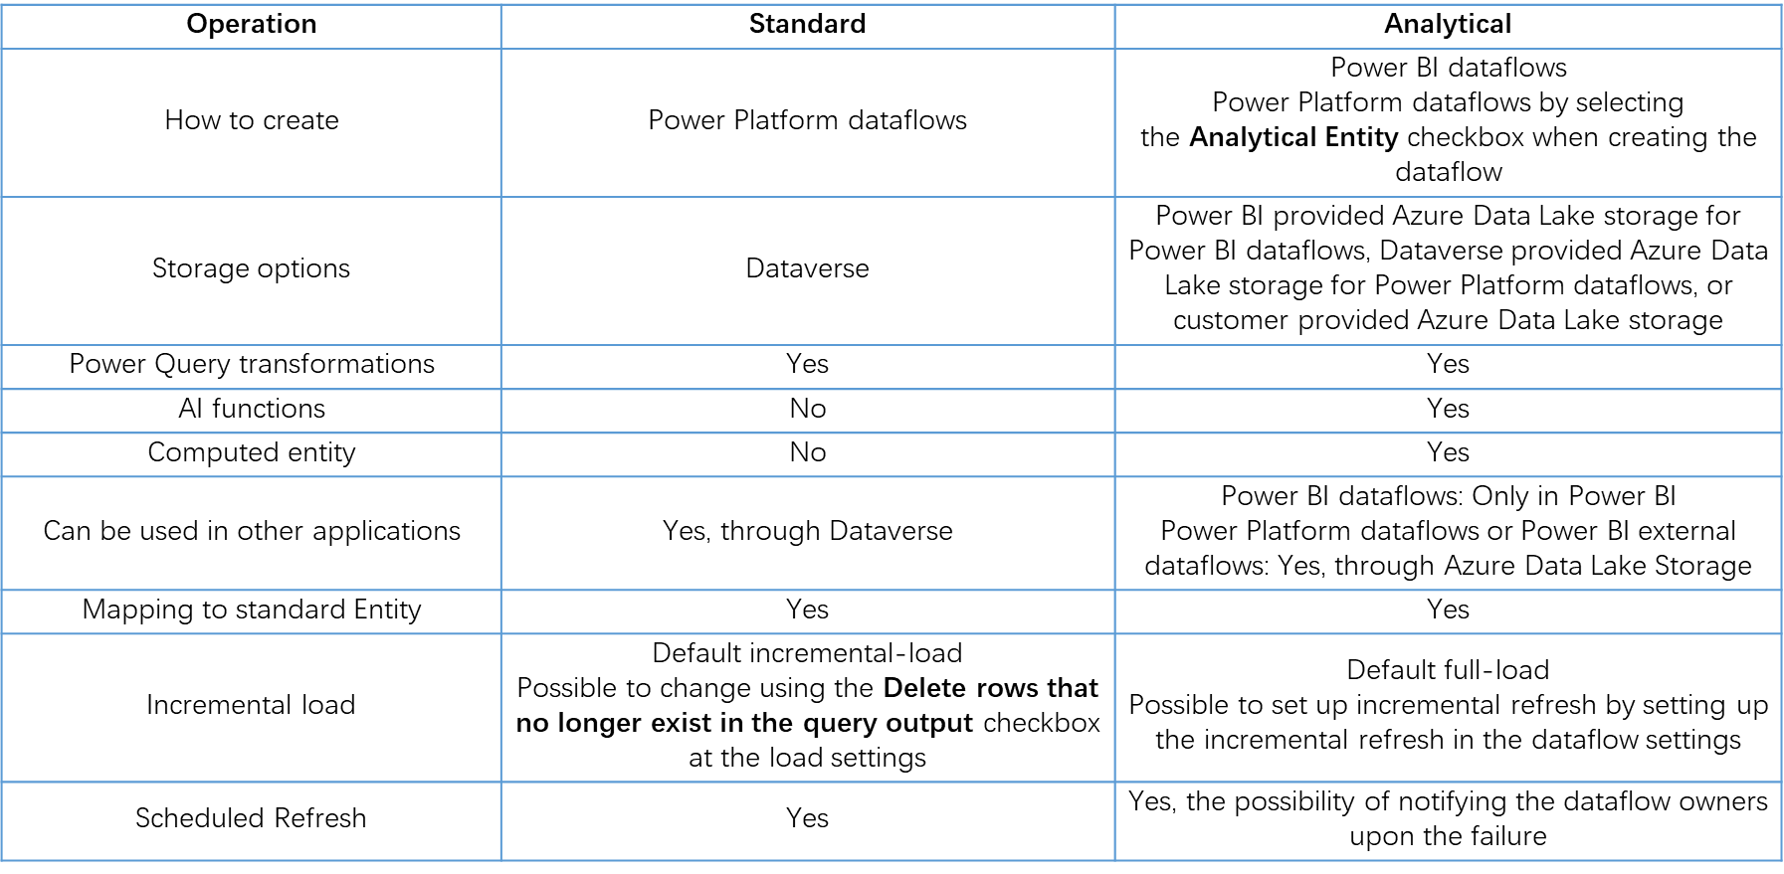
Dataflow types
Selecting a storage destination of a dataflow determines the dataflow's type. A dataflow that loads data into Dataverse tables is categorized as a standard dataflow. Dataflows that load data to analytical entities is categorized as an analytical dataflow.

Slide 4
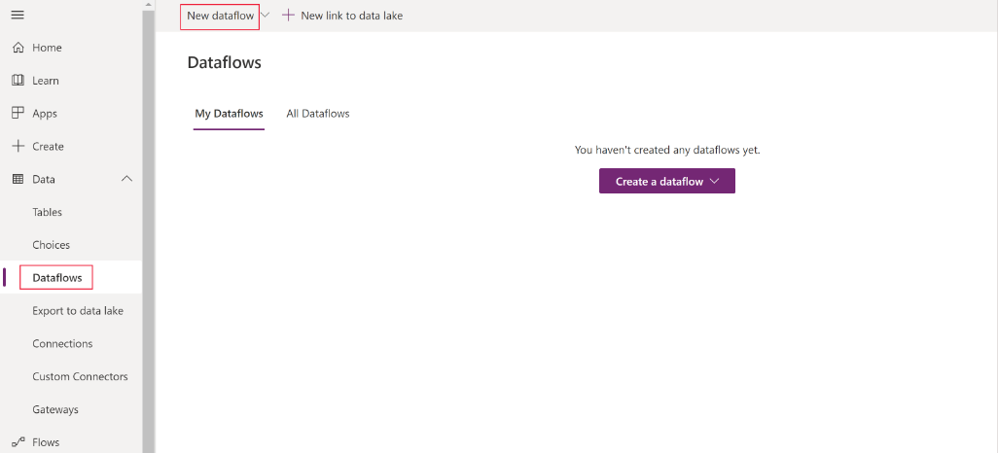
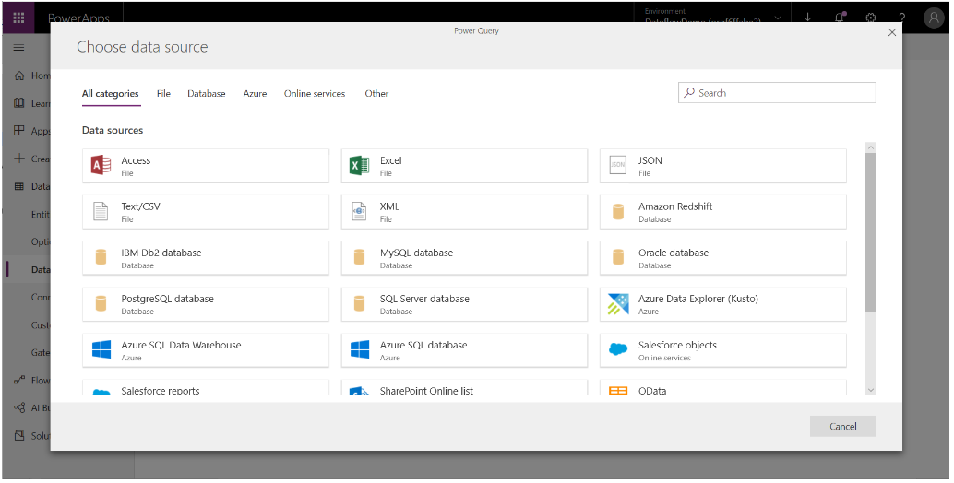
Primary steps to use a dataflow
Author the dataflow in the Power Apps portal. You select the destination to load the output data to, the source to get the data from, and the Power Query steps to transform the data using Microsoft tools that are designed to make doing so straightforward.
Schedule dataflow runs. This is the frequency in which the Power Platform Dataflow should refresh the data that your dataflow will load and transform.
Use the data you loaded to the destination storage. You can build apps, flows, Power BI reports, and dashboards or connect directly to the dataflow’s Common Data Model folder in your organization’s lake using Azure data services like Azure Data Factory, Azure Databricks or any other service that supports the Common Data Model folder standard.

Slide 5
Benefits of dataflows
Dataflow in Power Platform does not need an additional license, you can start to work with dataflows using licenses for Power Apps, Power BI, and Customer Insights.
Can load the data from Cloud, SaaS, On-premises data sources, and even personal computers (with authentication).
Dataflow can be a part of the Power Platform solution, hence it is easy to migrate it to different environments along with other components
It can handle a massive amount of data, unlike Power Automate which throttles if a number of API calls per minute or day cross the threshold limit.
The Power queries in Dataflow, Excel, and Power BI are the same. They are simple to transfer from one platform to another.
The tool is friendly and intuitive, any citizen developer can easily use.

Slide 6
Considerations of dataflows
There is only one owner of any dataflow, only the owner can edit the dataflow. You cannot share but only reassign the ownership.
You need to have created a solution before you can add a dataflow to it. Dataflows can't be edited directly from within solutions. Instead, the dataflow must be edited in the dataflows experience.
Environment variables can't be used by dataflows.
Users can’t add files or attachments to Dataverse while loading the data.
Dataflow has a refresh limit of two hours per entity.

Slide 7
Thank you

